Slide 1
Chain-Of-Hope: Blockchain for Ethical Blood and Organ Matching
TEAM MEMBERS:
GAUTHAM SANGARAJU (211423104162)
GUNJI VENKATA KRISHNA KARTHIK (211423104187)
GUIDE NAME: Mrs S. LINCY JEMINA M.E.,(Ph.D).,

Slide 2
THANK FOR YOUR GUIDENCE
PROJECT CO-ORDINATORS
Dr. P. DEEPA M.E., Ph.D.,
Associate Professor
Department Of CSE
Panimalar Engineering College
Mrs. S.LINCY JEMINA M.E., (Ph.D).,
Assistant Professor
Department Of CSE
Panimalar Engineering College

Slide 3
OUTLINE
INTRODUCTION
LITERATURE REVIEW
EXISTING SYSTEM
PROPOSED SYSTEM
SYSTEM ARCHITECTURE
PROPOSED METHODOLOGY
RESULT & OUTPUT
CONCLUSION & FUTURE WORK

Slide 4
ABSTRACT
By using blockchain technology to fight unethical behavior and illicit trade, the Chain-Of-Hope initiative offers a revolutionary method for blood and organ donation. The project tackles the worldwide organ trafficking issue while advancing health, justice, and institutional transparency in line with the UN’s Sustainable Development Goals (SDGs 3 and 16). Anonymous, moral, and traceable donor-recipient pairings are guaranteed by the system's secure matching protocol, which is driven by smart contracts and decentralized ledgers. To provide a scalable and reliable platform, the design combines Web3 technologies, Ethereum-based smart contracts, and simulation environments such as Ganache. Through gradual adoption, from pilot projects to widespread adoption, Chain-Of-Hope aspires to a time when every donation is protected by honesty, openness, and cutting-edge technology.

Slide 5
Introduction
The project addresses the global issue of illegal blood and organ trading, protecting vulnerable populations from exploitation and reducing corruption in medical donation systems.
By leveraging blockchain technology, the platform ensures that every donation is fully traceable, immutable, and transparent, preventing data manipulation or fraud.
Smart contracts and decentralized ledgers allow for secure, ethical, and anonymous matching of donors and recipients, safeguarding privacy while upholding medical ethics.
The initiative supports Sustainable Development Goals 3 (health and well-being) and 16 (peace, justice, and strong institutions) by promoting ethical healthcare practices and robust institutional trust.
Chain-Of-Hope aims to set a new benchmark for donation transparency and ethics worldwide, while providing a clear technical roadmap, implementation plan, and vision for future expansion.

Slide 6
Literature Review
s.no | Title | Authors | Venue/Journal & Date | Methodology | Inference | Limitations
1 | Self Sovereign Identity - Blockchain based Blood Donation Management Method | B. V. Santhosh Krishna; B. Rajalakshmi; K. Ashok; I. H. Gundoo; I. Aryan | ICSCSS, 2023 | SSI-enabled permissioned blockchain with smart contracts for donor registration, authentication, and traceable transfers | SSI on blockchain strengthens identity assurance and end-to-end traceability in blood workflows | EMR integration, privacy-preserving computation gaps, limited empirical evaluation
2 | Leveraging Blockchain and IoMT for a Smart Blood Donation System | L. Goudjil; S. Cherbal; N. E. Otmani; A. E. Khamedj; A. S. Mashaleh; A. Gawanmeh | ICCIAA, 2025 | IoMT telemetry to smart contracts for secure logistics, on-chain state, and verifiable queues | Combining IoMT with blockchain improves transparency and coordinated automation | Scalability/cost, on-chain attribute privacy, ecosystem readiness
3 | Survey on Organ Allocation Algorithms and Blockchain-based Systems for Organ Donation and Transplantation | C. Niyigena; S. Seol; A. Lenskiy | ICTC, 2020 | Survey of allocation rules and DLT architectures for auditability and anti-manipulation | DLT can enhance transparency, equity, and integrity in organ allocation | Few clinical trials, interoperability gaps, GDPR erasure tensions
4 | A Literature Review on Secured Data Management using Block Chain Technology in Healthcare Sector | S. Preethi; C. Priyadharsini | SMART GENCON, 2021 | Review of permissioned ledgers, audit trails, and data integrity controls | Permissioned DLT can improve integrity and trust in healthcare data flows | Limited large-scale deployments, regulatory friction, heterogeneous EHR standards
5 | Data Encryption of Blood-chain data in Blockchain Network | E. S. Priya; R. Priya | ICNWC, 2023 | Encryption-first design with blockchain anchoring for integrity and confidentiality | Cryptography plus immutability reduces tampering and disclosure risk | Key management complexity, metadata leakage, performance overhead

Slide 7
s.no | Title | Authors | Venue/Journal & Date | Methodology | Inference | Limitations
6 | Synergistic Revolution with AI-Enabled Organ Matching and Blockchain Security in Transplantation Management | Kumar P; Jeysankar N | ICAIT, 2024 | AI matching integrated with blockchain audit trails and allocation smart contracts | AI + blockchain can increase matching efficiency with verifiable logs | Explainability of models, feature privacy on-chain, need for clinical validation
7 | Medical Information Storage Model Based on Block Chain | W. Zi-chen; W. Xiao-yu; Y. Wan-jun; L. Jia-lan; Z. Huai-lin; C. Nai-meng | ICIIBMS, 2019 | Hybrid on-chain hashes/pointers with encrypted off-chain records | Preserves integrity and controlled access while limiting on-chain data | Key management, metadata linkability, cross-EHR interoperability
8 | Intelligent Decision Making with Block chain in healthcare industry | R. Roy; S. Pillai | IIHC, 2022 | Decision-support combining blockchain provenance with analytics/ML | Provenance-backed analytics can improve operational decisions | Data availability, model bias, workflow integration overhead
9 | Blood Bank Management System: Enhancing Security and Transparency in Blood Donation | J. N. P. Markavathi; R. Pandiarajan; S. Gurumoorthy; M. Madhankumar; V. Sharmi; J. Priyadharshika | ITIKD, 2025 | Smart contracts for registration, inventory, and traceable donations | Improves traceability and accountability in blood bank operations | Scalability/gas costs, compliance, lab/EMR integration
10 | Blockchain Traceability in Healthcare: Blood Donation Supply Chain | S. Sadri; A. Shahzad; K. Zhang | ICACT, 2022 | Ledger-backed custody events and quality checkpoints | Enhances end-to-end traceability and tamper-evidence in the blood chain | IoT data trustworthiness, throughput at peak loads, governance

Slide 8
s.no | Title | Authors | Venue/Journal & Date | Methodology | Inference | Limitations
11 | Organ Donation Decentralized Application Using Blockchain Technology | L. A. Dajim; S. A. Al-Farras; B. S. Al-Shahrani; A. A. Al-Zuraib; R. Merlin Mathew | ICCAIS, 2019 | DApp for decentralized registration, consent, and allocation logic | Decentralization can add transparency and reduce manual manipulation | Consent revocation vs immutability, sensitive attribute privacy, limited pilots
12 | Blockchain-Based Management for Organ Donation and Transplantation | D. Hawashin; R. Jayaraman; K. Salah; I. Yaqoob; M. C. E. Simsekler; S. Ellahham | IEEE Access, 2022 | End-to-end blueprint with role permissions, auditable allocation, and interoperability guidance | Feasible governance patterns for transparent organ donation management | No prospective trials yet, regulatory alignment, privacy-preserving computation gaps
13 | BDonor: A Geo-localised Blood Donor Management System Using Mobile Crowdsourcing | H. D. Das; R. Ahmed; N. Smrity; L. Islam | CSNT, 2020 | Mobile crowdsourcing for proximity-based donor recruitment and matching | Improves responsiveness via location-aware coordination | Location privacy, donor verification, sustained engagement
14 | Enhancing Organ Donor Matching and Transparency with Blockchain Technology | D. D. Priya; M. Naga Sreeya; A. Sanjana; P. Sarayu; M. K. Swamy | BITCON, 2024 | Blockchain-backed matching and transparency with automated notifications | Greater auditability and trust in allocation workflows | Fairness proofs, explainability, registry interoperability, benchmarking
15 | Blockchain-Based Organ Donation System: A Decentralized Solution for Transparent and Secure Transplant Matching | N. R. Kypu; B. K; D. V. Korla; V. Dwarakacharla; S. V. K | ICSCNA, 2024 | Decentralized platform for secure registration, matching, and auditable allocation | Transparency and tamper-resistance for multi-institution coordination | Governance/dispute resolution, multi-center performance, operational cost

Slide 9
Existing System
Before the implementation of a Self-Sovereign Identity (SSI) and blockchain-based blood & organ donation system, the existing solutions relied on:
Centralized Databases
Manual or Semi-Digital Verification
Lack of Real-Time Traceability
Trust and Security Issues
No User Ownership of Data

Slide 10
Disadvantages of the Existing System
Problem Area | Description
Data Privacy Risks | Central servers are vulnerable to hacking and unauthorized access.
Lack of Interoperability | Donor information cannot be seamlessly transferred across states or hospitals.
Identity Fraud | It is possible to fake donor IDs or forge eligibility reports.
Limited Donor Control | Donors have no visibility or authority over how their data is used.
No Immutable History | Donation and blood usage logs can be altered or hidden.
Paperwork & Delays | Verification and matching procedures are time-consuming and inconsistent.
Poor Incentivization | There is no structured way to reward or recognize regular, eligible donors.

Slide 11
Proposed System
Our project builds upon the concept of secure identity management and extends it to ethical organ matching,offering a transparent, auditable, and consent-driven system through blockchain and smart contracts.
Key Components:
BlockchainLedger
Self-Sovereign Identity (SSI)
Smart Contracts
Organ & Blood Registry
Consent Tokenization
Matching Engine (AI/Logic)

Slide 12
Advantages of the Proposed System
Feature | Benefit
Decentralized Trust | Eliminates dependence on a central authority—hospitals & donors operate transparently.
Immutable Data | All transactions (consent, donations, matches) are tamper-proof.
Ethical Matching | Ensures organ allocation follows fairness, priority rules, and consent.
Real-time Availability | Doctors can see cross-hospital availability instantly through the chain.
Improved Privacy | Sensitive data is shared only with permission using SSI and encryption.
Donor Empowerment | Donors can view how their data is used and even opt out.
Audit Trails | Full traceability of who accessed or altered donation records.
Automated Smart Contracts | Speeds up matching, confirmation, and logistics.
Disaster & Emergency Ready | Fast access to verified data in critical cases without red tape.

Slide 13
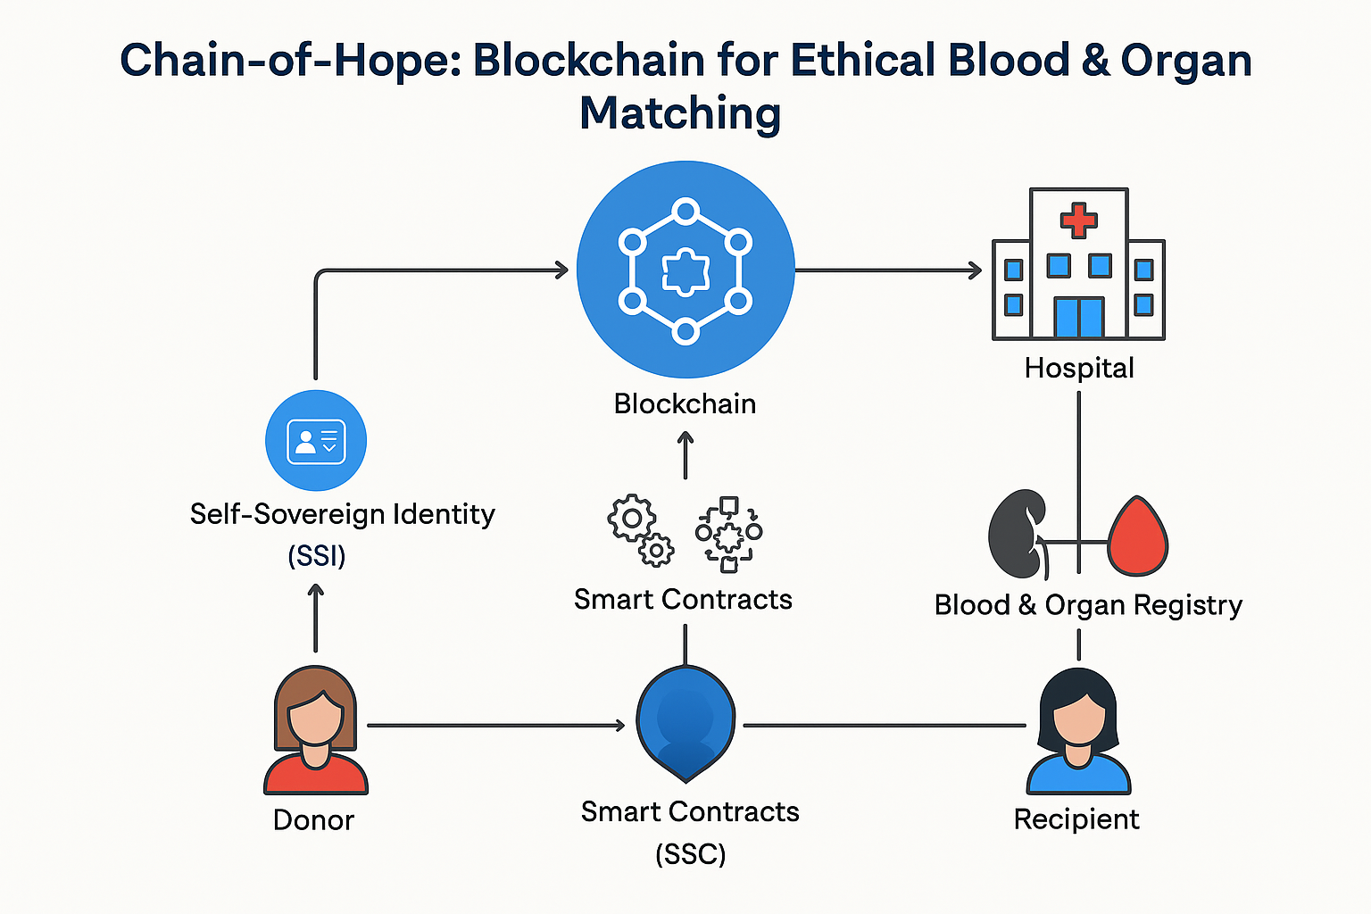
System Architecture

Slide 14
Proposed Methodology
1. User Registration and Authentication (with Self-Sovereign Identity)
2. Consent and Data Authorization
3. Medical Data Collection and Upload
4. Blood & Organ Matching Engine
5. Blockchain Ledger & Audit Trail
6. Notifications and Emergency Alerts
7. Admin Dashboard

Slide 15
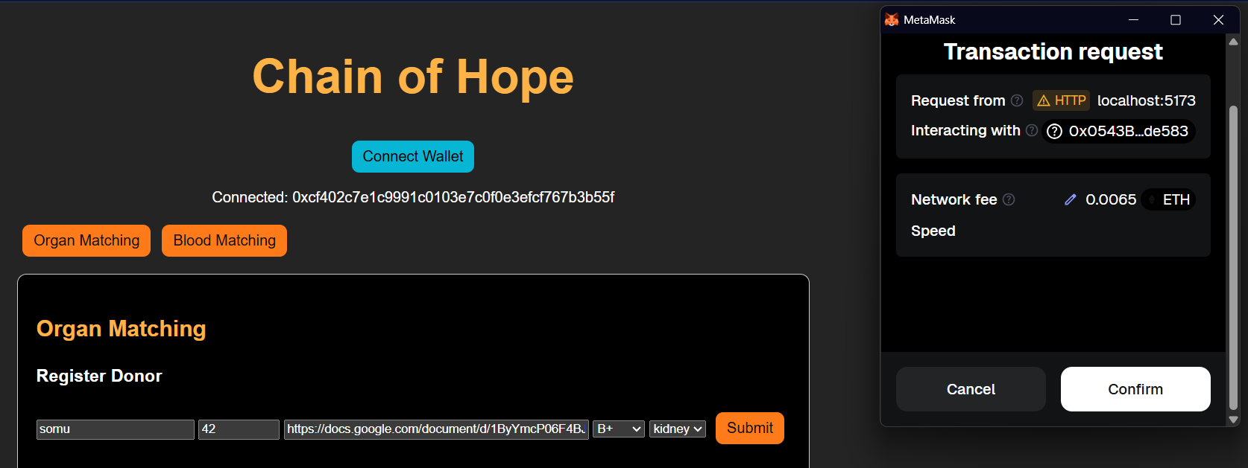
Module 1: User Registration and Authentication (with Self-Sovereign Identity)
Functionality:
Users (Donors, Hospitals, Recipients) register using a self-sovereign identity (SSI) framework.
Identity documents are cryptographically hashed and stored on the blockchain.
No centralized server stores personal data.
Technologies:
DID (Decentralized Identifiers)
Blockchain Wallets
ZKP (Zero-Knowledge Proofs)
Outcome:
Secure, tamper-proof identity
Full control of personal data by users

Slide 16
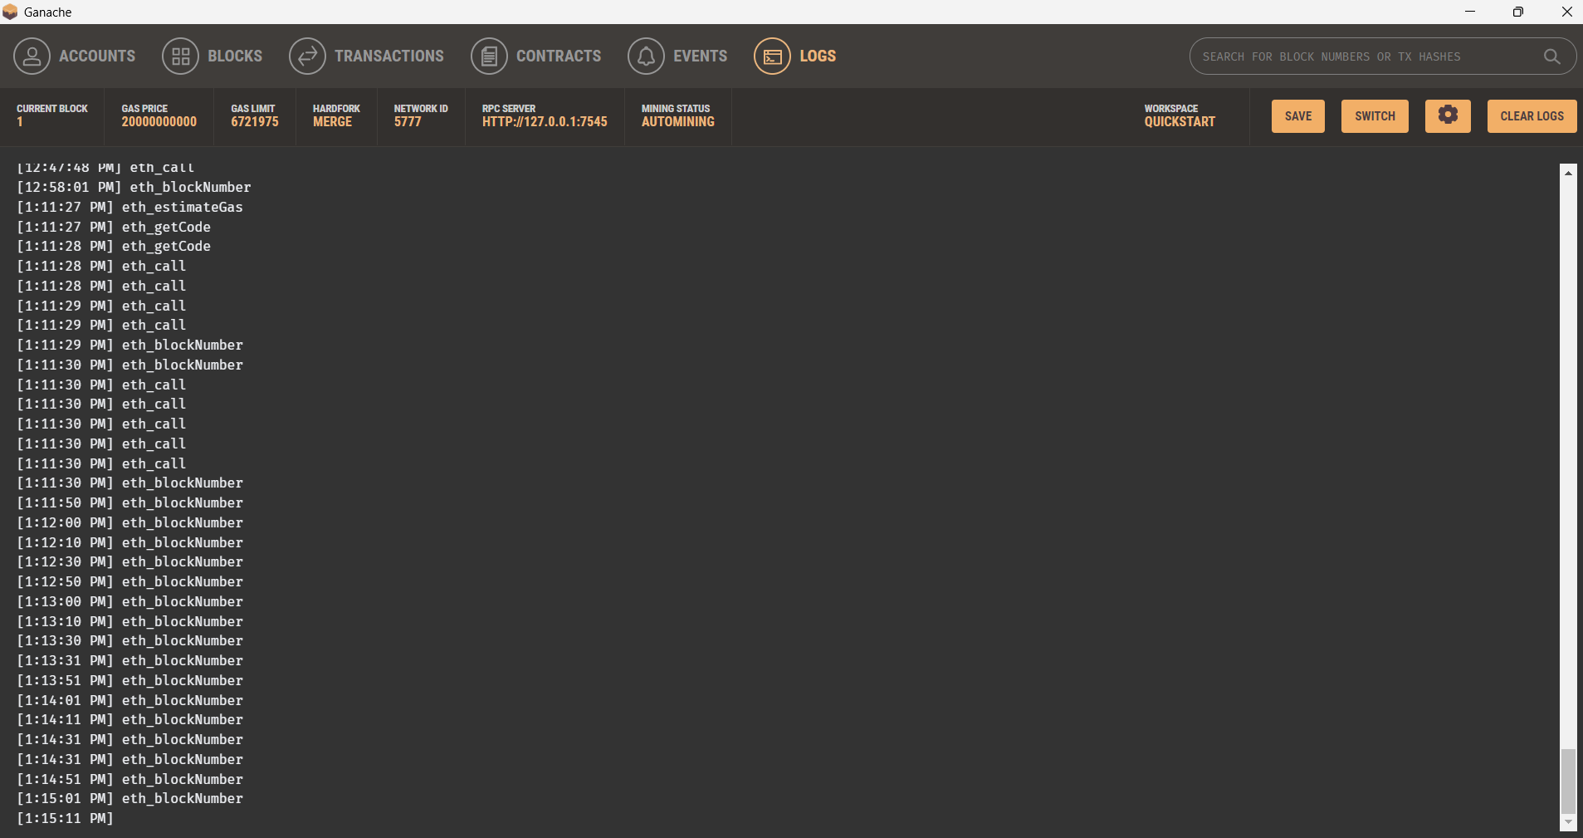
Module 2: Consent and Data Authorization
Functionality:
Donors must digitally consent before their medical details are accessed.
Hospitals or authorized personnel send consent requests via smart contracts.
Consent logs are stored immutably.
Technologies:
Consent tokens on smart contracts
Hash-based logging on blockchain
Outcome:
Ethical data sharing
Transparent consent history

Slide 17
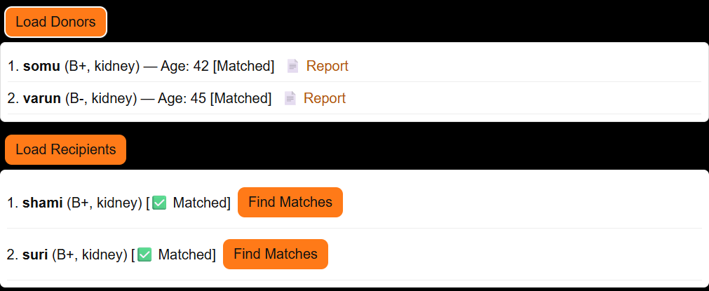
Module 3: Medical Data Collection and Upload
Functionality:
Donors upload encrypted medical data (blood group, organ compatibility, health status).
Doctors or verified nodes validate the data.
Only metadata is stored on-chain; full data is encrypted off-chain (e.g., IPFS).
Technologies:
IPFS / Encrypted cloud storage
Blockchain hash linking
Outcome:
Tamper-proof medical records
Reduces fraud and misinformation

Slide 18
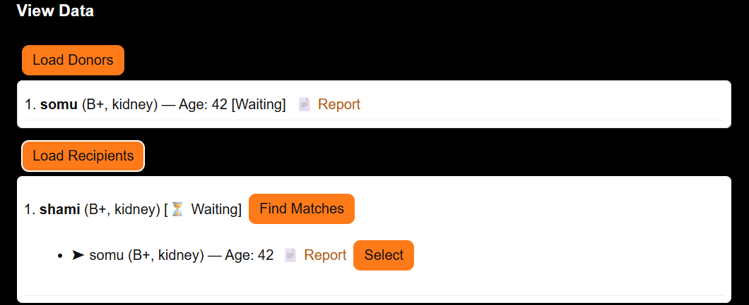
Module 4: Blood & Organ Matching Engine
Functionality:
Matching algorithm compares recipient needs to available donors.
Criteria: blood group, organ compatibility, geography, urgency, consent.
Smart contracts enforce ethical prioritization (e.g., critical cases first).
Technologies:
Smart contract-triggered match
Outcome:
Transparent and fair allocation
Zero manual bias or corruption

Slide 19
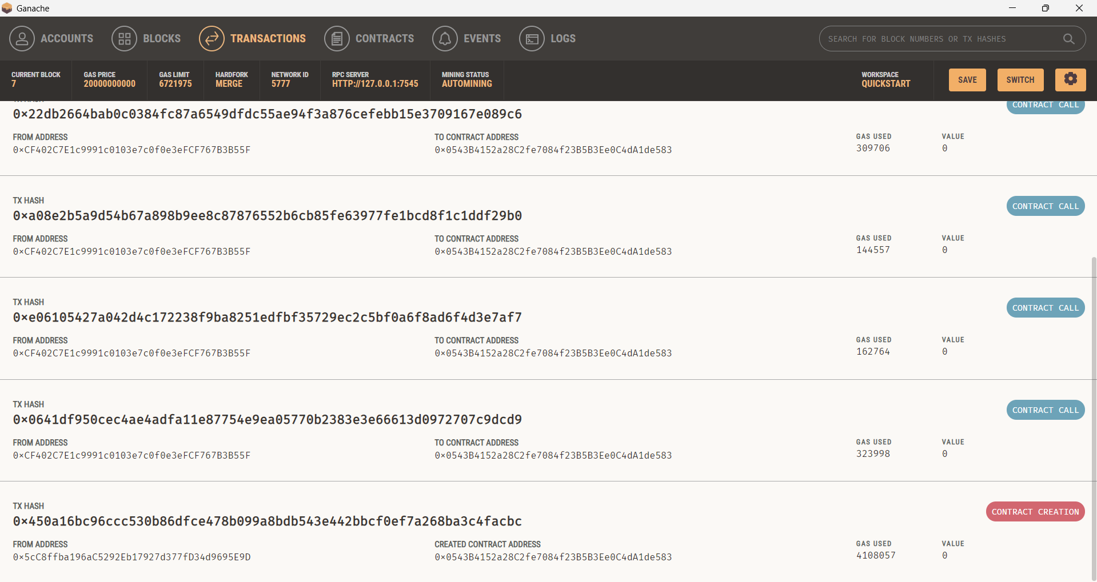
Module 5: Blockchain Ledger & Audit Trail
Functionality:
Every transaction (registration, consent, match) is recorded on a permissioned blockchain.
Immutable and verifiable logs for audits by health authorities.
Technologies:
Ethereum
Merkle Trees (for verification)
Outcome:
Verifiable trust layer
Government and NGOs can track unethical practices

Slide 20
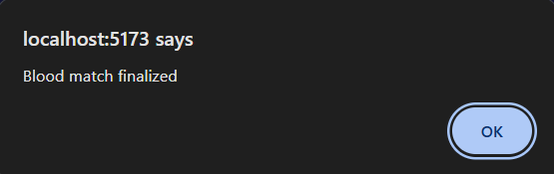
Module 6: Notifications and Emergency Alerts
Functionality:
Hospitals and patients are notified instantly if a match is found.
Emergency cases are escalated in the system.
Technologies:
Push notification services
Emergency APIs
Outcome:
Saves critical time in organ transport or urgent transfusion

Slide 21
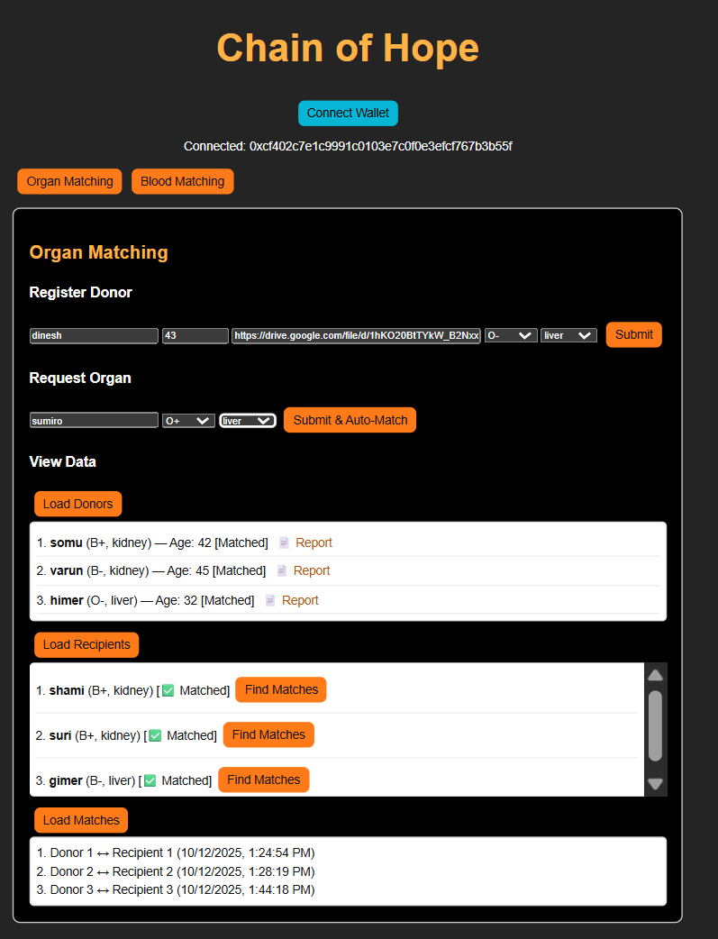
Module 7: Admin Dashboard
Functionality:
Authorized agencies (Health Dept, Red Cross) can view statistics, match logs, and verify ethical compliance.
Technologies:
Web3.js / React with blockchain backend
Outcome:
Governance support and transparency

Slide 22
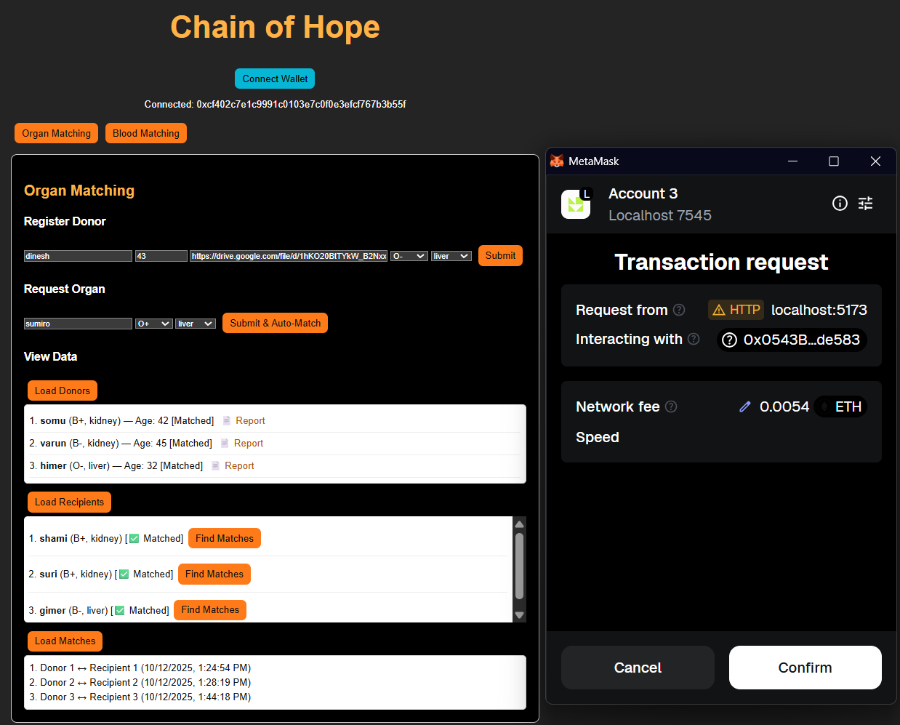
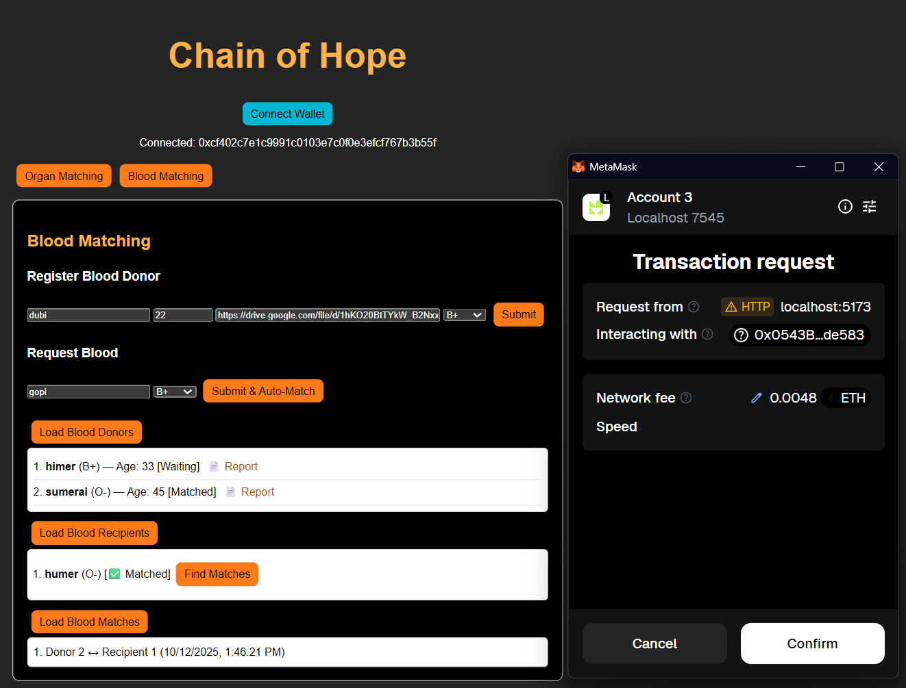
Result & Output
Screenshot of Organ Matching
Screenshot of Blood Matching

Slide 23
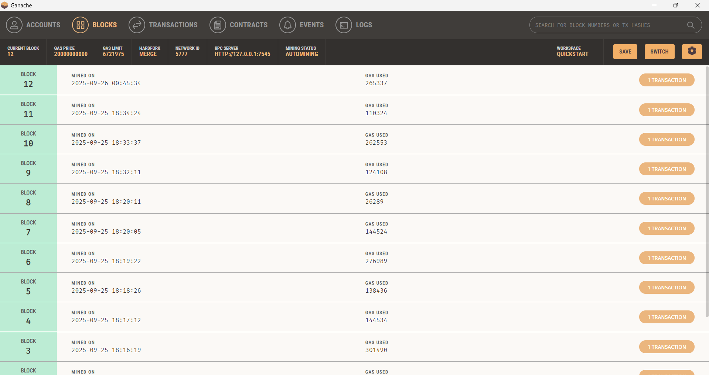
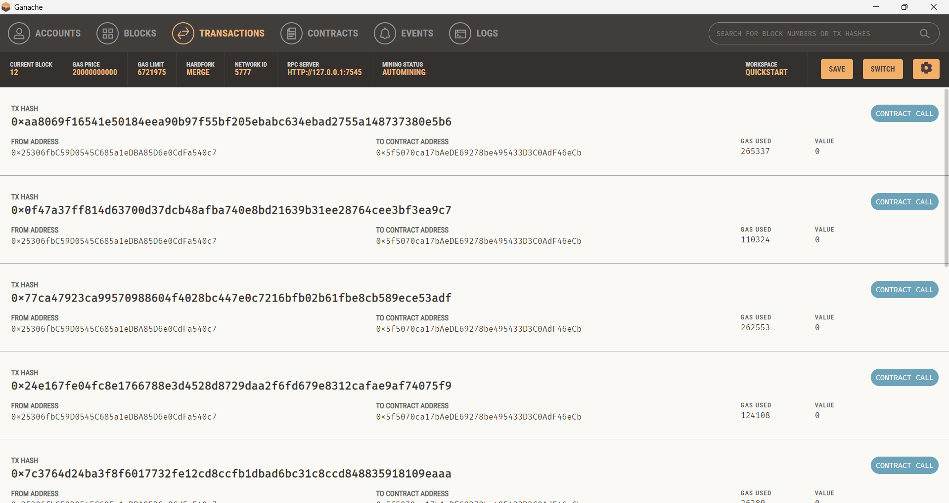
Screenshot of Blocks in Ganache
Screenshot of Transactions in Ganache

Slide 24
Conclusion and Future work
The Chain-Of-Hope concept shows how blockchain technology can transform the healthcare industry by guaranteeing security, trust, and transparency in the vital procedures of organ and blood donation. This technology ensures that donations are matched in an ethical and effective manner while reducing the dangers of fraud, illicit trade, and data manipulation by using decentralized ledgers and smart contracts. Additionally, the immutability and traceability of blockchain records boost trust between donors and recipients, encouraging increased involvement and equity. In the end, Chain-Of-Hope not only tackles the technological difficulties of safe data storage but also fortifies the moral underpinnings of life-saving medical procedures, opening the door to a more just and reliable healthcare system that protects patient privacy.
Future work should focus on privacy-preserving, secure, and interoperable donor-recipient matching, fair and explainable policies, scalable and resilient systems, clinician-friendly integration, measurable pilot outcomes, and mechanisms to maintain ethical and trustworthy operations.

Slide 25
References
[1] B. V. Santhosh Krishna, B. Rajalakshmi, K. Ashok, I. H. Gundoo and I. Aryan, "Self Sovereign Identity - Blockchain based Blood Donation Management Method," 2023 International Conference on Sustainable Computing and Smart Systems (ICSCSS), Coimbatore, India, 2023, pp. 1512-1520, doi: 10.1109/ICSCSS57650.2023.10169274.
[2] L. Goudjil, S. Cherbal, N. E. Otmani, A. E. Khamedj, A. S. Mashaleh and A. Gawanmeh, "Leveraging Blockchain and IoMT for a Smart Blood Donation System," 2025 1st International Conference on Computational Intelligence Approaches and Applications (ICCIAA), Amman, Jordan, 2025, pp. 01-06, doi: 10.1109/ICCIAA65327.2025.11013492.
[3] C. Niyigena, S. Seol and A. Lenskiy, "Survey on Organ Allocation Algorithms and Blockchain-based Systems for Organ Donation and Transplantation," 2020 International Conference on Information and Communication Technology Convergence (ICTC), Jeju, Korea (South), 2020, pp. 173-178, doi: 10.1109/ICTC49870.2020.9289421.
[4] S. Preethi and C. Priyadharsini, "A Literature Review on Secured Data Management using Block Chain Technology in Healthcare Sector," 2021 International Conference on Smart Generation Computing, Communication and Networking (SMART GENCON), Pune, India, 2021, pp. 1-5, doi: 10.1109/SMARTGENCON51891.2021.9645826.

Slide 26
[5] E. S. Priya and R. Priya, "Data Encryption of Blood-chain data in Blockchain Network," 2023 International Conference on Networking and Communications (ICNWC), Chennai, India, 2023, pp. 1-9, doi: 10.1109/ICNWC57852.2023.10127347.
[6] K. P and J. N, "Synergistic Revolution with AI-Enabled Organ Matching and Blockchain Security in Transplantation Management," 2024 Second International Conference on Advances in Information Technology (ICAIT), Chikkamagaluru, Karnataka, India, 2024, pp. 1-6, doi: 10.1109/ICAIT61638.2024.10690290.
[7] W. Zi-chen, W. Xiao-yu, Y. Wan-jun, L. Jia-lan, Z. Huai-lin and C. Nai-meng, "Medical Information Storage Model Based on Block Chain," 2019 International Conference on Intelligent Informatics and Biomedical Sciences (ICIIBMS), Shanghai, China, 2019, pp. 39-44, doi: 10.1109/ICIIBMS46890.2019.8991479.
[8] R. Roy and S. Pillai, "Intelligent Decision Making with Block chain in healthcare industry," 2022 International Interdisciplinary Humanitarian Conference for Sustainability (IIHC), Bengaluru, India, 2022, pp. 131-135, doi: 10.1109/IIHC55949.2022.10059753.
[9] J. N. P. Markavathi, R. Pandiarajan, S. Gurumoorthy, M. Madhankumar, V. Sharmi and J. Priyadharshika, "Blood Bank Management System: Enhancing Security and Transparency in Blood Donation," 2024 International Conference on IT Innovation and Knowledge Discovery (ITIKD), Manama, Bahrain, 2025, pp. 1-6, doi: 10.1109/ITIKD63574.2025.11005103.

Slide 27
[10] S. Sadri, A. Shahzad and K. Zhang, "Blockchain Traceability in Healthcare: Blood Donation Supply Chain," 2022 24th International Conference on Advanced Communication Technology (ICACT), PyeongChang Kwangwoon_Do, Korea, Republic of, 2022, pp. 1-8, doi: 10.23919/ICACT53585.2022.9728950.
[11] L. A. Dajim, S. A. Al-Farras, B. S. Al-Shahrani, A. A. Al-Zuraib and R. Merlin Mathew, "Organ Donation Decentralized Application Using Blockchain Technology," 2019 2nd International Conference on Computer Applications & Information Security (ICCAIS), Riyadh, Saudi Arabia, 2019, pp. 1-4, doi: 10.1109/CAIS.2019.8769459.
[12] D. Hawashin, R. Jayaraman, K. Salah, I. Yaqoob, M. C. E. Simsekler and S. Ellahham, "Blockchain-Based Management for Organ Donation and Transplantation," in IEEE Access, vol. 10, pp. 59013-59025, 2022, doi: 10.1109/ACCESS.2022.3180008.
[13] H. D. Das, R. Ahmed, N. Smrity and L. Islam, "BDonor: A Geo-localised Blood Donor Management System Using Mobile Crowdsourcing," 2020 IEEE 9th International Conference on Communication Systems and Network Technologies (CSNT), Gwalior, India, 2020, pp. 313-317, doi: 10.1109/CSNT48778.2020.9115776.
[14] D. D. Priya, M. Naga Sreeya, A. Sanjana, P. Sarayu and M. K. Swamy, "Enhancing Organ Donor Matching and Transparency with Blockchain Technology," 2024 International BIT Conference (BITCON), Dhanbad, India, 2024, pp. 1-5, doi: 10.1109/BITCON63716.2024.10985709.
[15] N. R. Kypu, B. K, D. V. Korla, V. Dwarakacharla and S. V. K, "Blockchain-Based Organ Donation System: A Decentralized Solution for Transparent and Secure Transplant Matching," 2024 International Conference on Sustainable Communication Networks and Application (ICSCNA), Theni, India, 2024, pp. 439-443, doi: 10.1109/ICSCNA63714.2024.10864115.

Slide 28
THANK YOU

